Slide 1
Daily Review
A stimulus is any information that the body receives, causing a response, e.g. a hot day or low blood sugar.
A receptor is a structure that detects a stimulus or change in the normal functioning of the body, and sends information to the brain.
Match the following sense organs with the stimulus that the receptors detect.
1. Eye A Pain, pressure, heat, cold
2. Ear B Light and movement
3. Nose C Chemicals in food
4. Tongue D Chemicals in the air
5. Skin E Vibrations in air particles

Slide 2
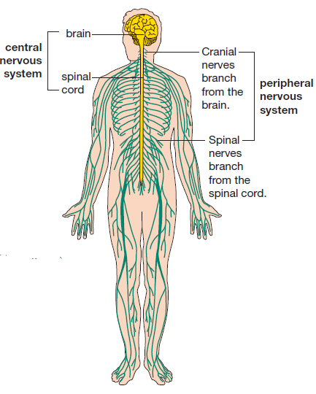
Daily Review
The nervous system is a communication system that controls all parts of the body.
The human nervous system has two main parts: Central Nervous System and the Peripheral Nervous System.
What structures are these two nervous systems composed of?

Slide 3
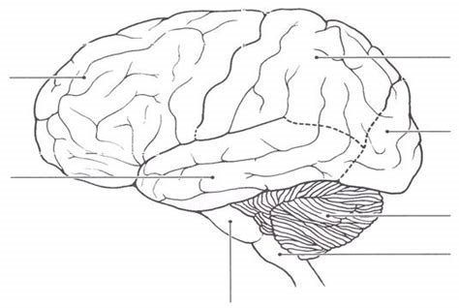
Daily Review
The central nervous system (CNS) is the control centre of the body. It consists of the brain and spinal cord.
Match up the parts of the brain with the appropriate letter.
Temporal Lobe
Occipital Lobe
Cerebellum
Brain Stem
Parietal Lobe
Frontal Lobe
Spinal Cord
G
A
F
B
E
D
C

Slide 4
Central and Peripheral Nervous Systems
Year 9 Biology

Slide 5
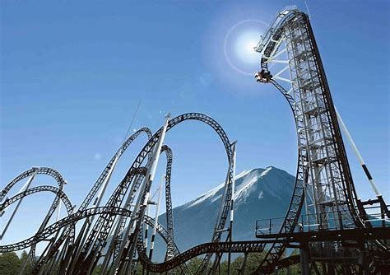
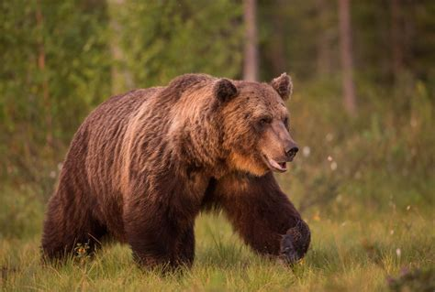
Learning Objectives
CFU
What are we going to learn?
Describe the function of the central and peripheral nervous systems.
Identify and describe the somatic and autonomic nervous systems.
Activate Prior Knowledge
Humans are constantly receiving stimuli from their environment. Our bodies then respond in certain ways.
Think, Pair, Share:
How would you respond in these scary situations;
a rollercoaster ride
a bear attack?

Slide 6
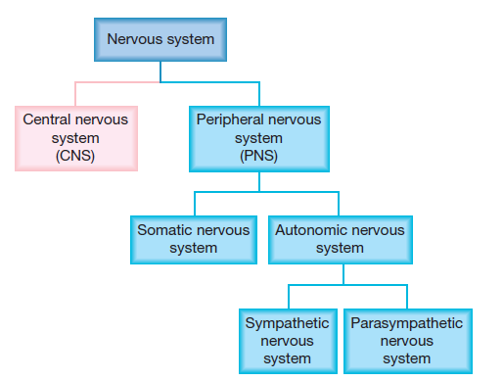
Concept Development
CFU 1
How are the central and peripheral nervous systems different?
Divisions of the Nervous System
The Central Nervous System is composed of the brain and spinal cord.
The Peripheral Nervous System is composed of the nerves in the limbs and organs.
The Peripheral Nervous System is divided into the Somatic Nervous System and the Autonomic Nervous System.
Each of these divisions controls different important functions of the body.
CFU 2
What are the two parts of the peripheral nervous system?

Slide 7
Concept Development
CFU 1
What does the Somatic Nervous System control?
CFU 2
True or False: Stimuli in environment include temperature, light, touch, smell and sound.
Somatic Nervous System
The somatic nervous system (SNS) collects information receptors from our sense organs.
It then coordinates movement of the body in response, by controlling voluntary muscle movements.
For example: taking a jumper off in hot weather, or drinking water to cool down.
CFU 3
Think, Pair, Share: Describe another response to a stimulus the SNS would control.

Slide 8
Concept Development
CFU 1
What does the Autonomic Nervous System control?
Autonomic Nervous System
The autonomic nervous system (ANS) controls involuntary actions of the body.
These actions include heartbeat, digestion, respiration, salivation, pupil size, and perspiration.
The ANS is responsible for maintaining the body’s internal environment.
CFU 2
What does involuntary mean?
Vocabulary
Perspiration: the process of sweating Involuntary: done without conscious control

Slide 9

Skill Development/Guided Practice
Identifying Division of Nervous System
Do we have voluntary control of this action? If yes – Somatic NS If no – Autonomic NS
Lisa’s pupils dilate when she walks into a dark room.
Which division of the nervous system is controlling this action?
The Autonomic Nervous system is controlling Lisa’s pupils dilating, because she does not have voluntary control of this action. It is involuntary.
Vocabulary
Voluntary: done with conscious control Involuntary: done without conscious control

Slide 10
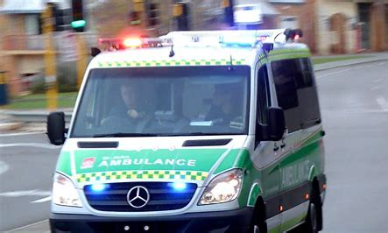
Skill Development/Guided Practice
Identifying Division of Nervous System
Do we have voluntary control of this action? If yes – Somatic NS If no – Autonomic NS
Rodney turns his head to look in the direction of the ambulance siren.
Which division of the nervous system is controlling this action?
The Somatic Nervous system is controlling Rodney’s head, because he has voluntary control of this action. It is completed with conscious effort.
Vocabulary
Voluntary: done with conscious control Involuntary: done without conscious control

Slide 11
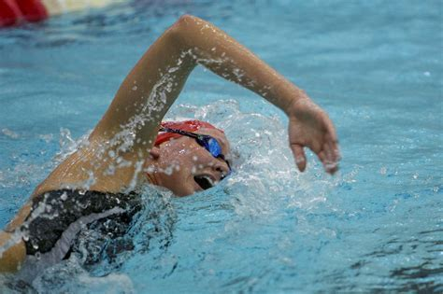
Skill Development/Guided Practice
Identifying Division of Nervous System
Do we have voluntary control of this action? If yes – Somatic NS If no – Autonomic NS
Alicia’s heart beats faster while she is swimming laps.
Which division of the nervous system is controlling this action?
The Autonomic Nervous system is controlling Alicia’s heart, because she does not have voluntary control of this action. It is involuntary.
Vocabulary
Voluntary: done with conscious control Involuntary: done without conscious control

Slide 12

Skill Development/Guided Practice
Identifying Division of Nervous System
Do we have voluntary control of this action? If yes – Somatic NS If no – Autonomic NS
Troy claps his hands after the band has finished playing.
Which division of the nervous system is controlling this action?
The Somatic Nervous system is controlling Troy’s hands, because he has voluntary control of this action. It is done with conscious effort.
Vocabulary
Voluntary: done with conscious control Involuntary: done without conscious control

Slide 13
Relevance
Our bodies are complex organisms that are constantly interpreting external and internal information.
Knowing about the nervous system and the effects it has on the body help you understand how our body coordinates its movement and internal environment to help us to survive.

Slide 14
Skill Closure
How are the central and peripheral nervous systems different?
Skill Closure
Explain the difference between the somatic and autonomic nervous systems.
Skill Closure
Cassie is running along a beach. Which division of the peripheral nervous system is in control while:
Cassie is running, and
Her breathing rate increases?
Identifying Division of Nervous System
Do we have voluntary control of this action? If yes – Somatic NS If no – Autonomic NS
Vocabulary
Voluntary: done with conscious control Involuntary: done without conscious control

Slide 15
Independent Practice
Copy and complete the following table, in your book or on your device.
Action | Division of Nervous System | Justification
Salivating while chewing gum.
Sweating on a hot day.
Scratching an itch.
Dancing to a song.
Digesting food.
Drinking hot chocolate.
Marigold
Rafflesia
Trumpet Vine
Cactus
Jasmine
Bottlebrush

